Slide 1
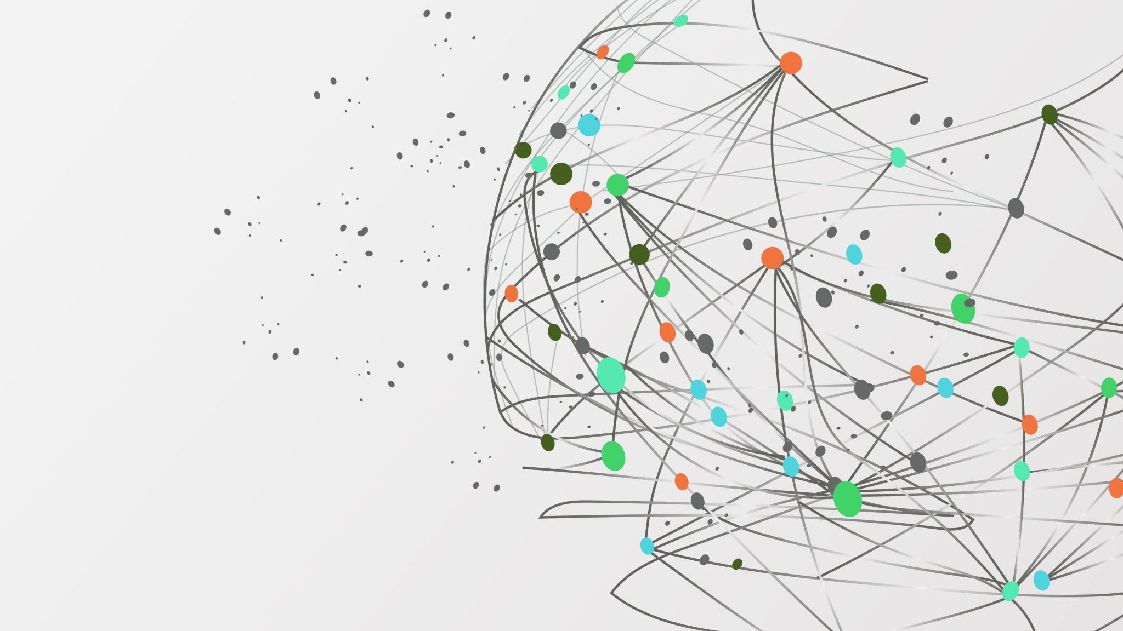
Indian Sign Language Recognition and Sentence Generation
Mangal Deep Singh
19857
MTech. AI

Slide 2
CONTENT
Introduction
Problem Statement
Related Work
Proposed Method
Dataset
Model Architecture
Training and Results
Conclusion and Future Work
Objective
Challenges
Applications

Slide 3
INTRODUCTION
Indian Sign Language is used by the speech impaired people of India to communicate with each other.
It involves making gestures using movement of hand, face and pose.
The lack of knowledge of ISL to general population makes it difficult for them to communicate with the deaf and mute people.
The idea is to work on narrowing down this communication gap with the help of deep learning tools.

Slide 4
Objective
To develop an automatic sign language recognition system with the help of deep learning techniques.
To be able to recognize hundreds of words by recognizing different gestures of hand, pose and face.
To facilitate the communication between speech impaired people and the rest.
To efficiently and accurately translate the gestures to text format.

Slide 5
PROBLEM STATEMENT
This project has been divided into two problems:
ISL Recognition: In this problem, the model we are using must detect the gesture from the input and then classify it as one of the words in the vocabulary that the gesture represents. So, it is a classification task.
ISL Sentence Generation: At this step, we have to use the recognized words in the previous step and with the help of Large Language Models (LLMs), we try to generate a meaningful and grammatically correct sentence that is being conveyed with the help of gestures.

Slide 6
RELATED WORK
In past, most of the work done was using static gestures and very little has been done with dynamic gestures.
Work done by Singha et al.[2] deals with static gestures.
Pigou et al.[3] used a dataset that consisted of 20 Italian sign gestures. Then, he was CNN model having 6 layers for feature extraction and used ANN for classification. He achieved accuracy of 91.70%.
Similar work was done by J Huang[4], where he created a dataset of 25 words using Kinect. He got average accuracy of 94.2%.

Slide 7
RELATED WORK
In another work by Geetha, they used 50 sample of every alphabet and digits. The region of interest of the sign gesture was analysed and the boundary was removed. Then, it underwent a series of smoothening to extract the features. SVM was used to classify the images and the accuracy of the model was 90.00%.
In the work done by Pratik Likhar et al.[1], they worked on sentence-level translation. The dataset was generated by themselves. The dataset had 12 different sentences and for each sentence, there were 8 videos.

Slide 8
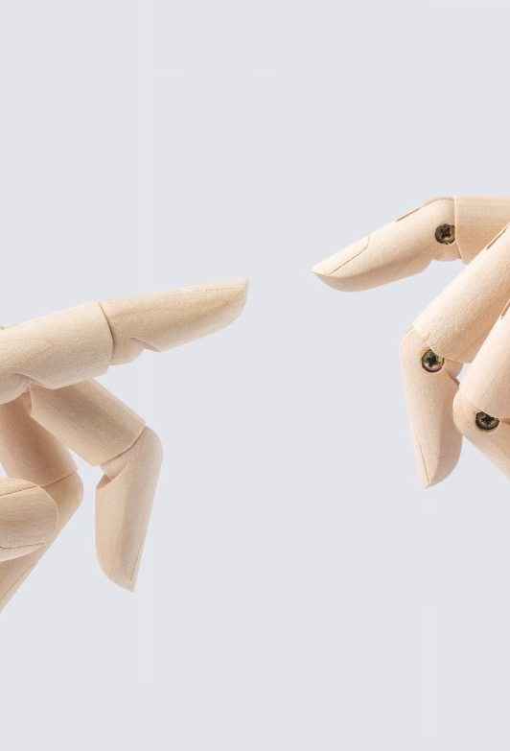
PROPOSED METHOD
ISL Recognition
Used MediaPipe Holistic model to extract the landmark points for hand, pose and face as they are involved in making different gestures for each frame.
This data is now fed to the classifier model to classify the gesture as one of the words in the vocabulary.
Since the data we are dealing with is sequential data, we have used LSTM (Long Short Term Memory) as the classification model because they are good for dealing with sequential data.
Store all the recognized words in a list.

Slide 9
PROPOSED METHOD
ISL Sentence Generation
The list of recognized words during the ISL Recognition is fed to the LLMs.
We have used two LLMs: BERT and ChatGPT.
Both the LLMs are given the list of recognized words as input.
Based on the input words, the LLMs generate a meaningful sentence.

Slide 10
DATASET
Since ISL severely lacks availability of a large enough dataset for training of deep learning models, I have dedicated some time on creating a small dataset for this task.
I have used MediaPipe Holistic model to capture the dataset.
Tried capturing the samples for the dataset in different conditions to make model robust.
For a given frame, MediaPipe Holistic model captures a total of 1662 landmark points, shown in Table 1, and store them in a NumPy file.

Slide 11
DATASET
We have not used Face landmark points during training and testing of this model, so only 258 landmark points are stored.
The dataset contains a total of 30 words. For each word, there are 30 samples and for each sample, there are 30 NumPy files stored in sequential manner.
Gesture | Landmark Points
Face | 1404
Pose | 132
Hand | 126
Dataset Size | (30*30*258)
Total Words | 30
Samples per Word | 30
Landmarks per Sample | 258
Table 1. MediaPipe total landmark points. Table 2. Dataset details.

Slide 12
MODEL ARCHITECTURE
To build this project, I have used 3 models.
MediaPipe Holistic Model: This model has been used to extract the landmark points from the input frame. This is used for detecting the gesture using the position of hand, face and pose.
LSTM Classification Model: This model has been used for word recognition task. It has been used to classify the detected gesture as one of the words in the dataset.
BERT and ChatGPT: These language models has been used to generate sentences using the recognized words. This model then generates the translated output as text. We have used BERT for comparison.

Slide 13
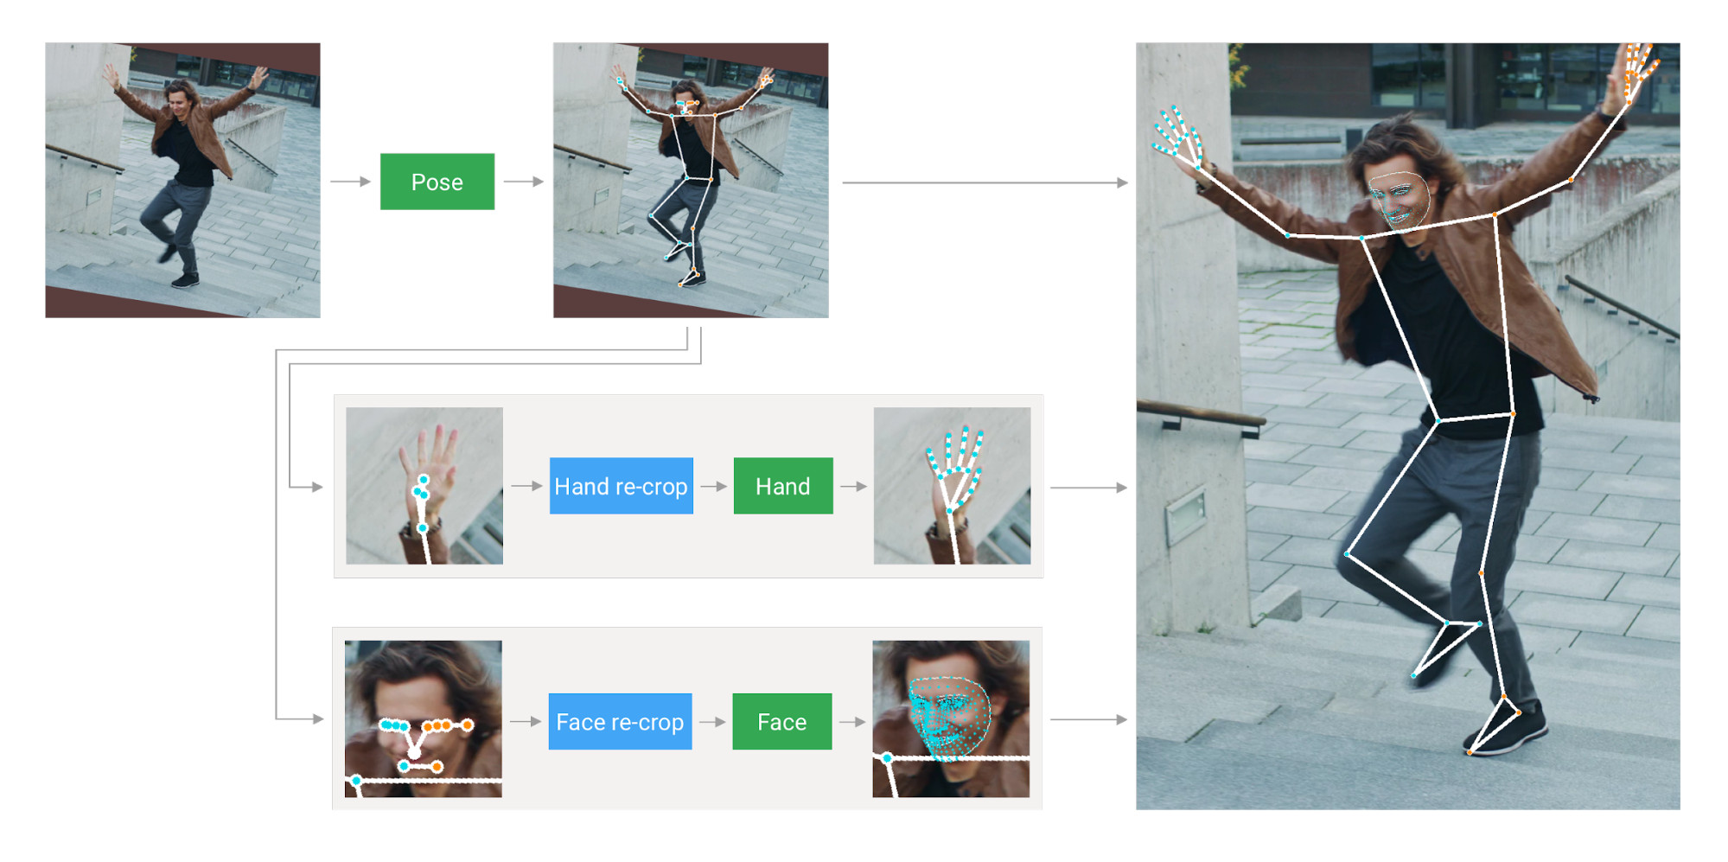
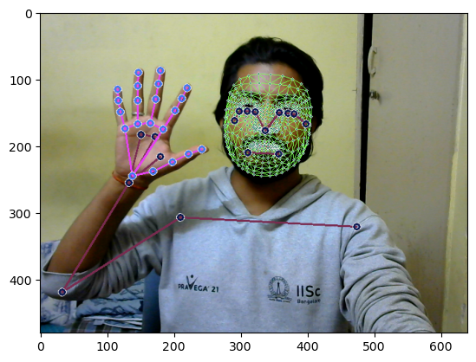
MODEL ARCHITECTURE
MediaPipe Holistic Model
It enables simultaneous detection of pose, hand and face landmarks.
Works well with time series data like video and audio.
Can be used for real-time inferencing.
Fig. 1. MediaPipe Holistic Model Fig. 2. MediaPipe landmark detection.

Slide 14
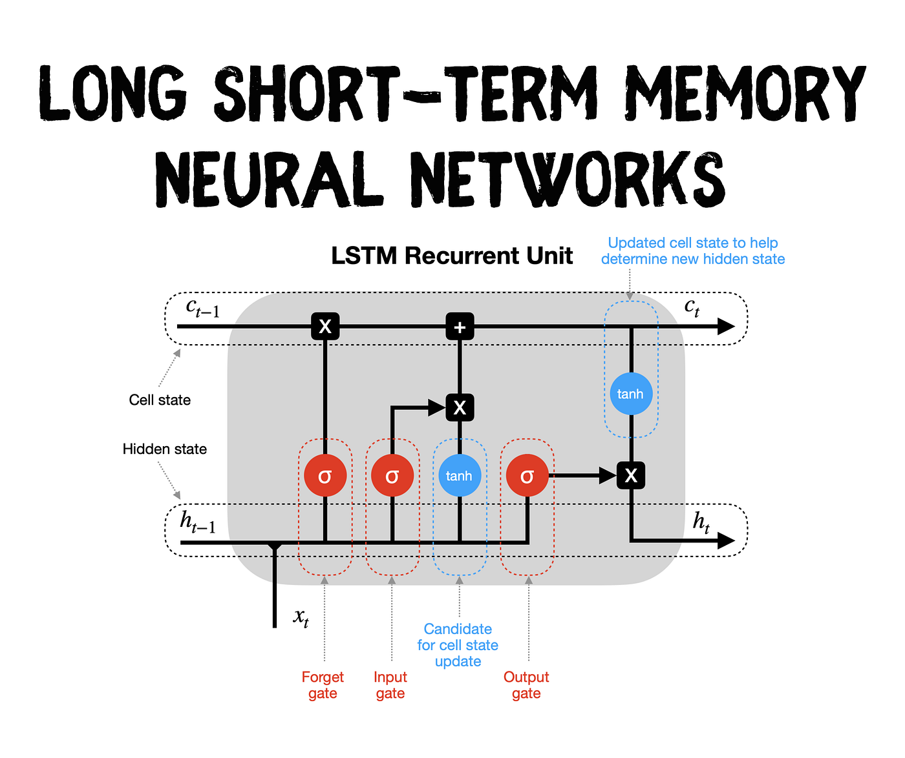
MODEL ARCHITECTURE
LSTM Classification Model
Used for classifying the input gesture as one of the words in the dataset. Classification is done based on the output of the SoftMax layer.
Ideal for our current dataset as it contains sequential data.
Fig. 3. LSTM Architecture

Slide 15
MODEL ARCHITECTURE
BERT
Can be used for text generation task.
Trained on massive dataset of 3.3 Billion words.
Used Masked Language Modelling (MLM), where BERT must predict the MASKED word based on the other words in the input.
The input format to BERT for recognized words is shown below:
Words: [What, you, name]
Input : [MASK] What [MASK] you [MASK] name [MASK]

Slide 16
MODEL ARCHITECTURE
ChatGPT
AI model that uses deep learning to generate human-like text based on user prompts.
Used for sentence generation with the help of recognized words:
Takes user prompt as input and generates output based on the prompt.
Input prompt used for ChatGPT:
Words: [What, you, name]
Input: Generate a sentence using these words: What, you, name.

Slide 17
Advantages of the models used
Improved accuracy in recognizing sign language gestures.
Able to recognize a larger vocabulary of signs.
Faster processing time compared to traditional models.
Required less training data.
Potential for real-time recognition for communication purpose.

Slide 18
TRAINING and RESULTS
Train-Test Split: Used 80:20 split for the train and test data respectively.
LSTM classifier was trained on the train data. Each sample is appended a label and then fed to the LSTM model.
The accuracy of the model reaches to 1
for epoch 200.
The parameters of the model are shown
in the table.
Parameters | Value
Number of layers | 6
Number of epoch | 200
Input shape | (30, 258)
Activation Function | ReLU
Optimizer | Adam
Loss Function | Categorical_crossentropy
Evaluation Metric | Categorical_accuracy
Table. 3. LSTM Parameters

Slide 19
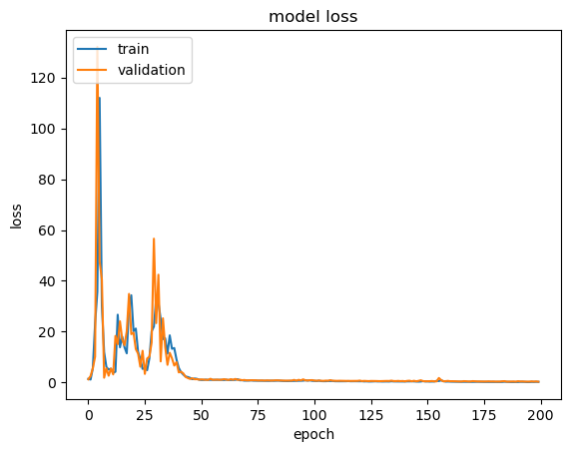
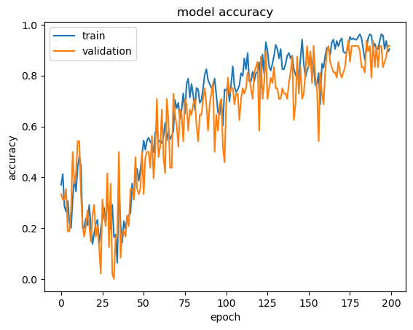
TRAINING and RESULTS
The training accuracy is about 1 and the accuracy on the test data is 95%.
The loss and accuracy plot for the train and the validation data during training is shown below:
Fig. 4. Loss vs Epoch graph
Fig. 5. Accuracy vs Epoch graph

Slide 20
TRAINING and RESULTS
The flow chart for this model is shown below.
LSTM Classifier
MediaPipe Holistic Model
Input frame
Landmark points
ChatGPT
Sentence Generation
Output Sentence
Recognized Words

Slide 21
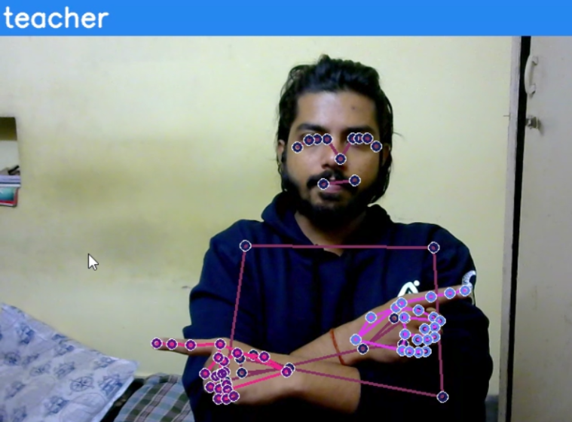
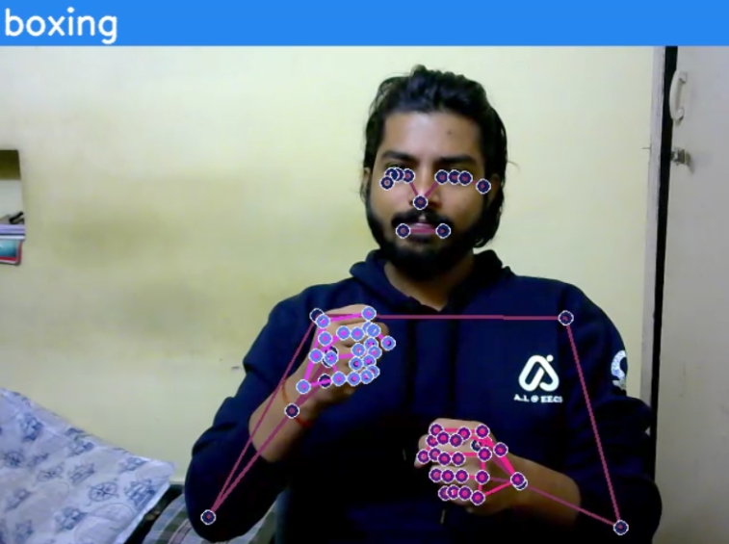
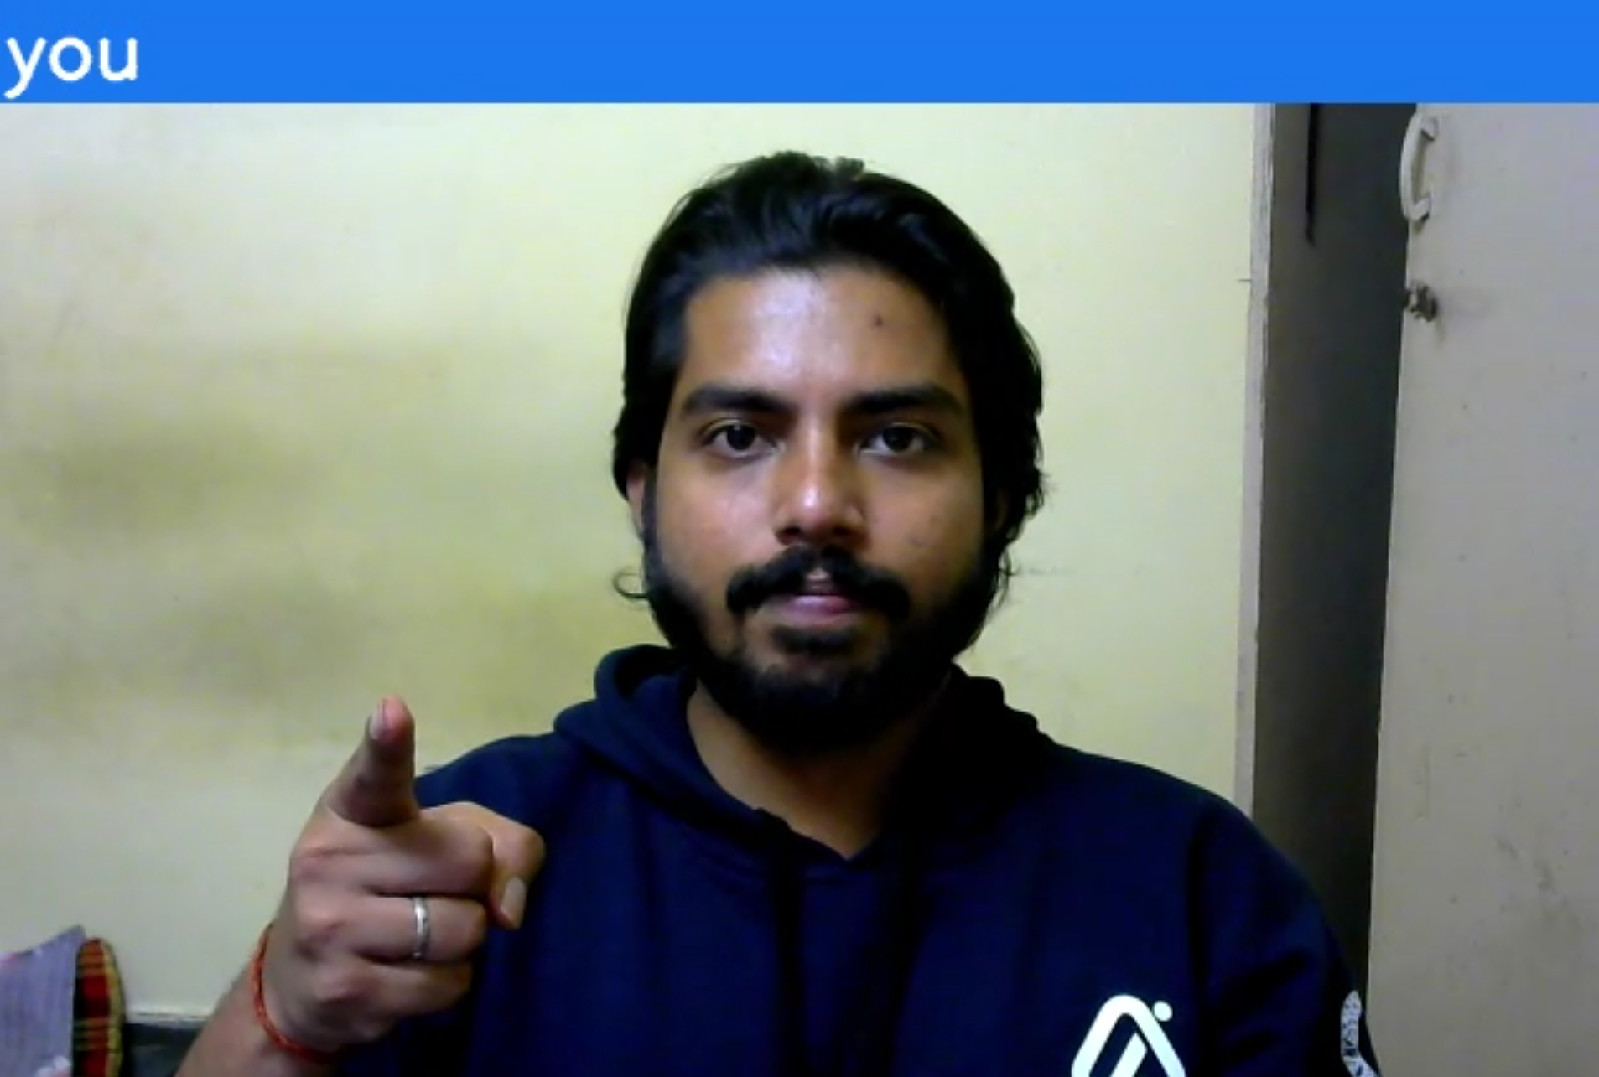
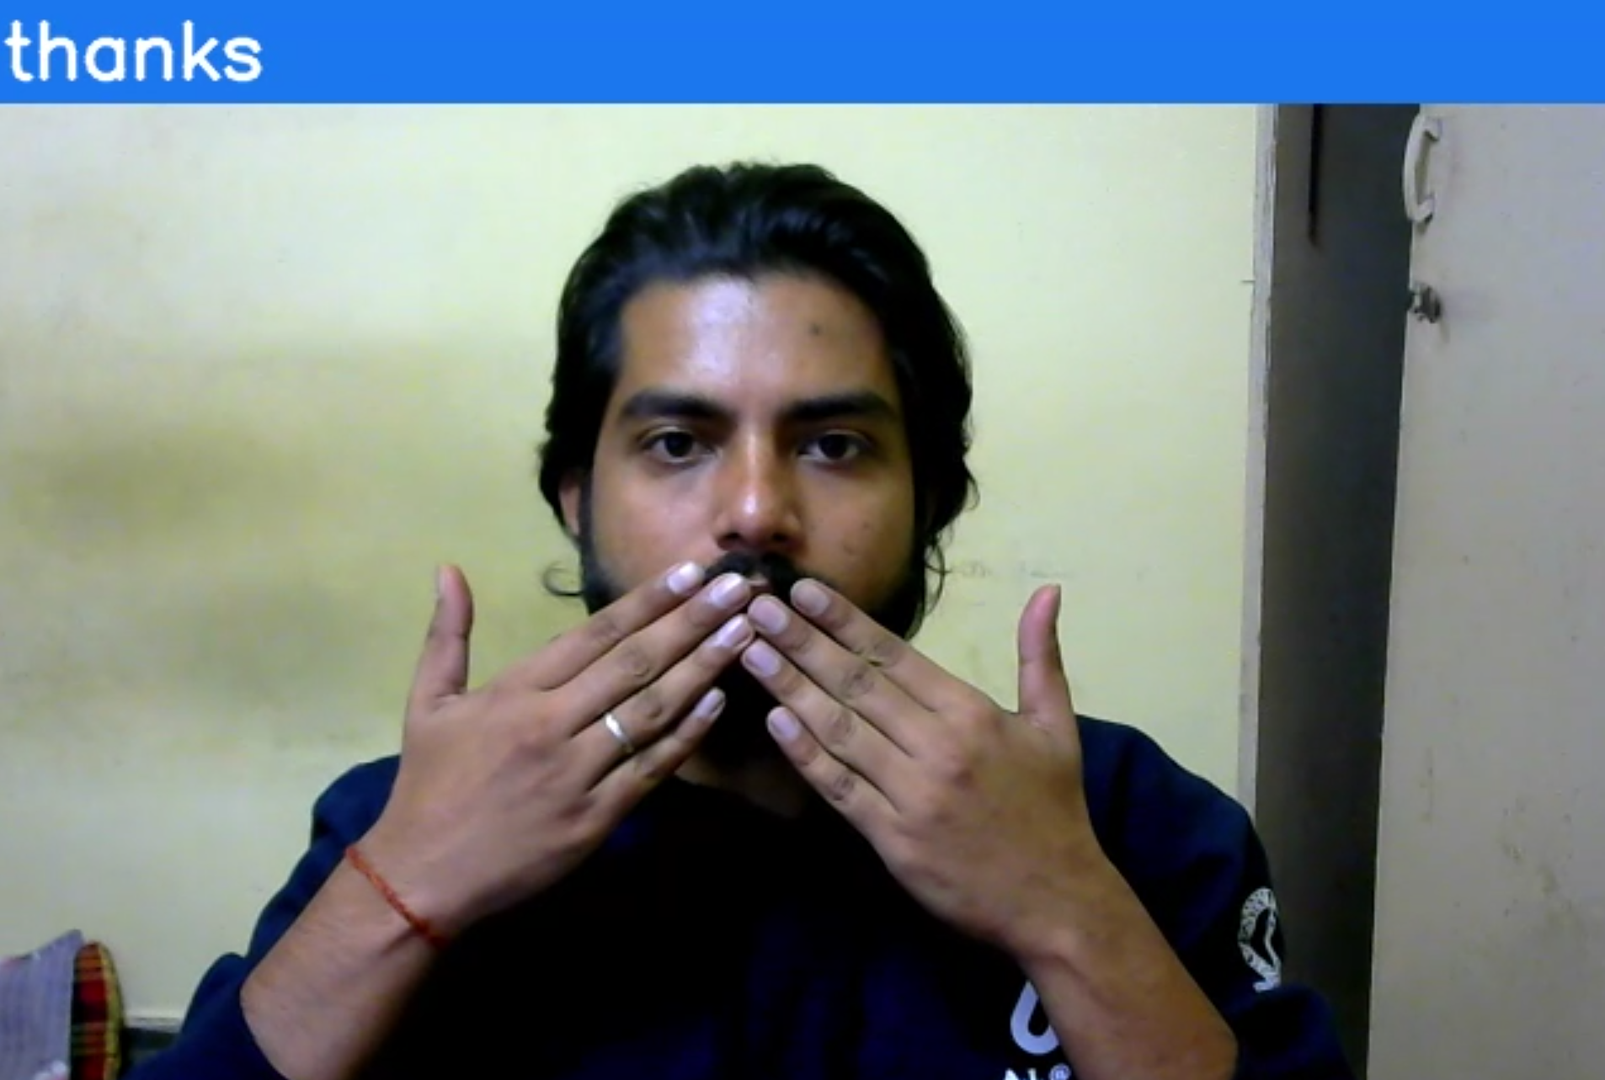
RESULTS
The model was able to accurately recognize most of the words in the dataset. Below images show the model doing correct prediction based on the landmark points detected.
Fig. 5. Words recognized: teacher, boxing, you, and thanks.

Slide 22
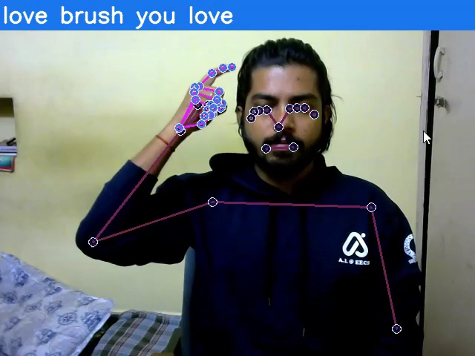
RESULTS
This video demonstrates the real-time working of the model.
It can recognize most of the words correctly.
The words at the top represent the words recognized with the right one being the most recent.
When a new word is recognized, it gets appended to the list and the oldest one (left most) is removed from the list.

Slide 23
RESULTS
ChatGPT was able to generate human-like and better sentences as compared to BERT. Below table compares the results of BERT and ChatGPT.
Input words | BERT Output | ChatGPT Output
brush, you, eat, time | a brush and you can eat next time. | You brush your teeth every time you eat.
what, name, you | what a name are you? | What is your name?
I, time, you, boxing | I have time when you in boxing. | I have time for you to go boxing.
I, fine | I am fine. | I’m fine.
Teacher, think, read | the teacher would think and read. | The teacher thinks students should read more.
You, think, what | you can think , what? | You think what?

Slide 24
APPLICATIONS
Education: For assisting teachers and students in communication and learning.
1
Accessibility: Enabling access to information for the speech impaired community in various fields.
2
Healthcare: Facilitates communication with deaf and mute patients resulting in better care.
3
Technology: Can be integrated with other products and services for the deaf community.
4

Slide 25
CHALLENGES
ISL is very different from other sign languages because of cultural, geographical and historical context.
Lack of standardization of signs.
Complexity of ISL grammatical structure.
Limited available ISL dataset.

Slide 26

CONCLUSION
While working on this project, my aim was to develop a real-time translation application which can be used to narrow the communication gap between speech impaired and the rest of the population.
There was lack of data for this task, so I worked on creating a small working dataset.
Need to be careful while capturing the gestures as the movement of the hand matters a lot.
Also, the model sometimes misclassifies the words having similar gesture.

Slide 27
FUTURE WORK
A possible future can be developing a comprehensive ISL dataset with larger vocabulary size, include gesture for common phrases and words.
Exploring tools that can improve the accuracy of ISL recognition models and make quick real-time recognitions.
It can be enhanced by translating it to speech so that blind people can benefit from it.
Can work on developing educational tools and applications that integrate ISL recognition to aid in teaching and communication.

Slide 28
REFERENCES
[1] P. Likhar and G.N. Rathna. Indian sign language translation using deep learning. In In 2021 IEEE 9th Region 10 Humanitarian Technology Conference (R10-HTC) (pp. 1-4). IEEE., 2021.
[2] Joyeeta Singha and Karen Das. Indian sign language recognition using eigen value weighted Euclidean distance-based classification technique. arXiv preprint arXiv:1303.0634, 2013.
[3] Pigou L., Dieleman S., Kindermans PJ., Schrauwen B. (2015) Sign Language Recognition Using Convolutional Neural Networks. In: Agapito L., Bronstein M., Rother C. (eds) Computer Vision – ECCV 2014 Workshops. ECCV 2014. Lecture Notes in Computer Science, vol 8925. Springer, Cham.
[4] Huang, J., Zhou, W., & Li, H. (2015). Sign Language Recognition using 3D convolutional neural networks. IEEE International Conference on Multimedia and Expo (ICME) (pp. 1-6). Turin: IEEE.

Slide 29

Thank You!

